Slide 1
Automatic Arm Warmer
Georgia Institute of Technology - ECE 4781 - Biomedical Instrumentation
Samuel Ruiperez Campilo, Joseph Doughty, Anand Dugad, Jae Hyun Kim, Samruddhi Kulkarni
December 4th, 2018

Slide 2
Project Scope
Problem
Statement
Solution Overview
Design
Conclusions
Physiological Responses
Description
Prototype
Block Diagram
Temperature
Shivering
Finger Flexion
Arduino
Results
Future Work

Slide 3
Problem Statement
People who have frequent exposure to cold environments may experience a higher likelihood of the following:
Cold stress
Hypothermia
Lower back and knee pain
Frostbite
Fatal cold-related accidents
Additionally, workers in cold environments may have lowered efficiency with handheld tools due to shivering, an involuntary bodily response to low body temperature

Slide 4
Solution Overview
A prototype of a solution was designed in the form of an armband that senses when the following conditions are all true simultaneously:
Low ambient temperature
Shivering of the wearer’s arm
Flexion (closing) of the wearer’s fingers
When all three conditions are met, a heating pad activates for five minutes
This is intended to stop the shivering, increase work efficiency, and prevent long-term physiological effects from repeated cold exposure

Slide 5
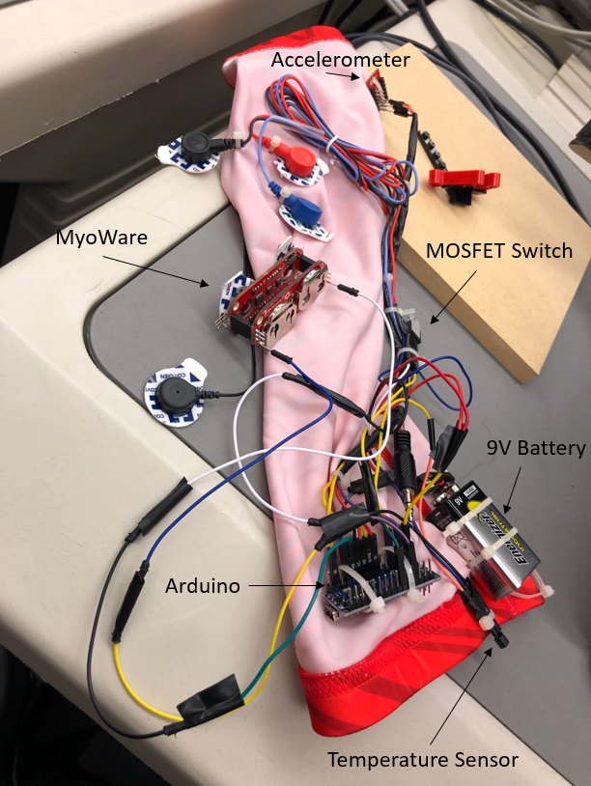
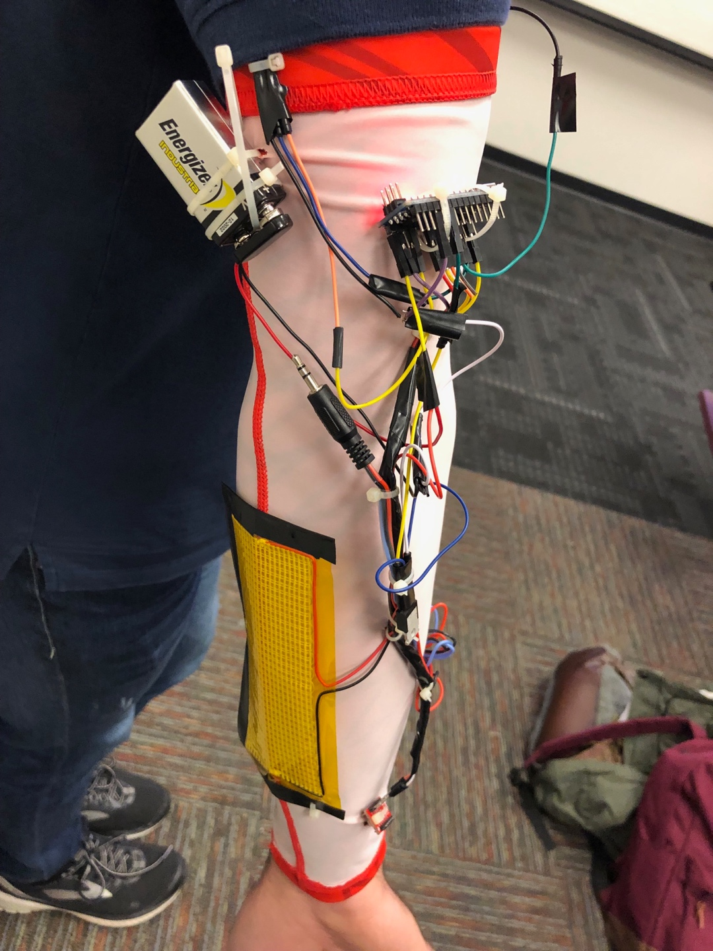
Prototype
Figure 1. Photo of armband prototype.
Figure 2. Photo of armband prototype on an arm.

Slide 6
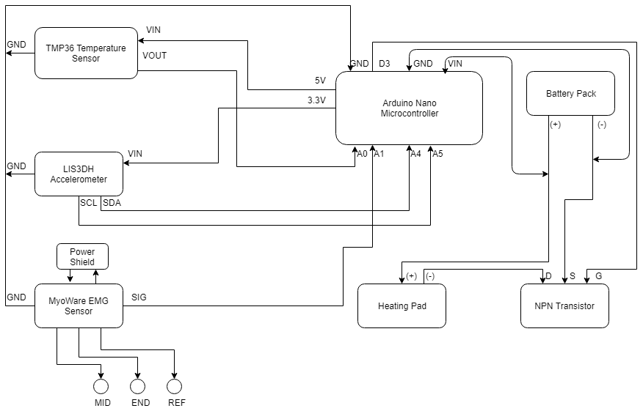
Block Diagram
Figure 3. Block diagram of the electronic system in the armband.

Slide 7
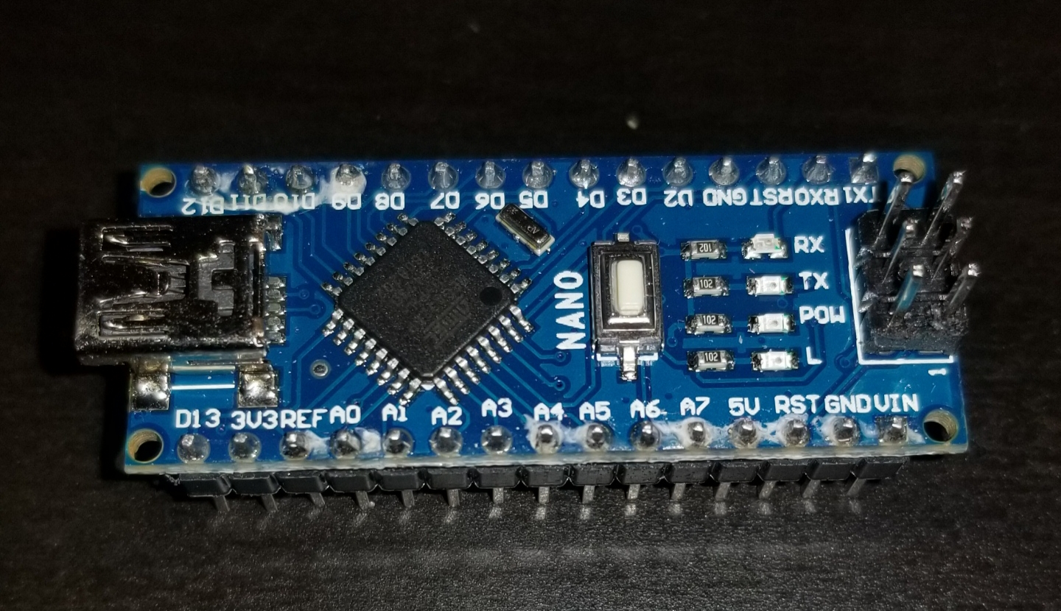
Microcontroller
Arduino Nano
Located on the upper arm
Manages input and output signals
Executes looping program to check condition status
Figure 4. Arduino Nano microconotroller.

Slide 8
Temperature Measurement
TMP36 Temperature Sensor
Located on the upper arm
Outputs a voltage based on surrounding temperature
Parameters | Min | Typical | Max
Temperature Range | -40°C |  | 150°C
Output Range | 0.1V |  | 2.0V
Power Supply Range | 2.7 V |  | 5.5V
Scale Factor |  | 10 mV/°C
Table 1. Specifications of the TMP36 Temperature Sensor [1].

Slide 9
Shiver Detection
LIS3DH Accelerometer
Located at the wrist
Outputs x, y, and z positions
t
LIS3DH 3-Axis Accelerometer
Located at the wrist to detect rapid small movements from shivering

Slide 10
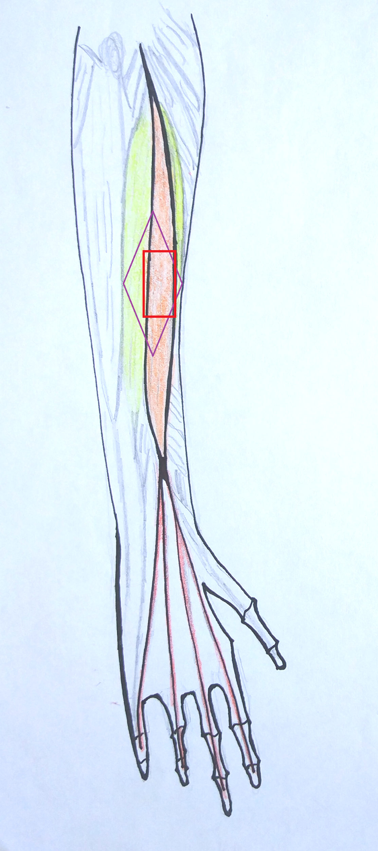
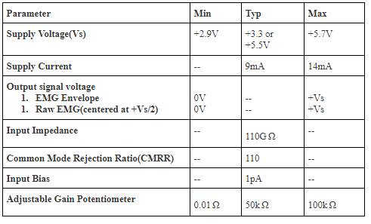
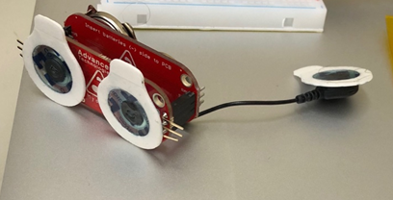
Finger Flexion Sensing
MyoWare electromyography (EMG) sensor
Outputs a voltage between 0V and 3.3V based on amplitude of signal
Mid and End electrodes go on muscle of interest
Reference electrode placed on bone or less active tissue
Ground Reference
Electrode
Mid, End Electrodes
Table 3. Specifications of the
MyoWare sensor unit [6].
Figure 8. Diagram of the
Right Arm (Extensor Digitorum).
Figure 9. The MyoWare sensor unit.

Slide 11
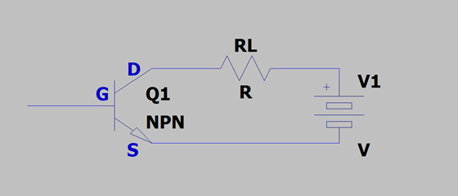
Design - Power
NPN Transistor (Switch)
N-channel MOSFET used as a switch between the battery and the heating pad
Signal from the Arduino is routed to the gate
“High” signal applied to the gate completes the circuit and powers the heating pad
Figure 11. LTSpice circuit diagram showing the NPN transistor, the load resistance (the heating pad), and the battery.

Slide 12
Results and Future Work
Results
Prototype functioned as expected
Future Work
Select material which fits well, is comfortable, and protects components
Base shiver detection on actual human shiver tremor frequency
Optimize power and balance battery pack with ideal use case

Slide 13
References
[1] Sparkfun, “Temperature Sensor – TMP36” Sparkfun.com, No Date. [Online]. Available: https://www.sparkfun.com/products/10988. [Accessed Dec. 1, 2018].
Pritchard, Justin. “Starting a Car in Winter (and Even Without a Block Heater).” AutoTRADER.ca, 18 Jan. 2017, www.autotrader.ca/newsfeatures/20170118/starting-a-car-in-winter-and-even-without-a-block-heater/.
“The Benefits of Medical Illustrations.” Ghost Productions | Medical Animation Studio, 15 Aug. 2018, ghostproductions.com/blog/animation/benefits-medical-illustrations/.
Amazon, “Volt Heated Work Gloves” Amazon.com, No Date. [Online]. Available: https://www.amazon.com/Volt-Heated-Work-Gloves-Rechargeable/dp/B019HKQOLW [Accessed Nov. 7, 2018].
ST, “ MEMS digital output motion sensor: ultra-low-power high-performance 3-axis “nano” accelerometer” LIS3DH datasheet, Dec. 2016.
“TMP36 Temperature Sensor.” Memory Architectures | Memories of an Arduino | Adafruit Learning System, learn.adafruit.com/tmp36-temperature-sensor/overview.
Sparkfun, “MyoWare Muscle Sensor” Sparkfun.com, No Date. [Online]. Available: https://www.sparkfun.com/products/13723 [Accessed Nov. 6, 2018].
Sparkfund, “N-Channel MOSFET 60V 30A” Sparkfun.com No Date. [Online]. Available: https://www.sparkfun.com/products/10213 [Accessed Dec 2, 2018].

